Slide 1
B-Shopping
THE BEST SHOPPING Experience You will ever have.
Present By Team

Slide 2
Outline
Motivation
Introduction
Implementation
Demo

Slide 3
Motivation
Security of user accounts
Fake accounts resulting in frauding
Logistics companies monopolize the delivering market
Fully utilize the concept of Sharing Economy
Notes:
create

Slide 4
Introduction (1/3)
A totality distributed marketplace
B2C + C2C
Everyone can be a carrier
Sharing economy
Notes:
create

Slide 5
Introduction (2/3)
Fully protect of user privacy
User profiles will be encrypted
Private Information will not be utilized to make profit(e.g. Advertising)
Notes:
create

Slide 6
Introduction (3/3)
Authentic and stable transaction
A basic threshold to create a new account
Reputation system is introduced to avoid frauding
Notes:
create

Slide 7
Implementation
Smart Contract
Friendly UI
IPFS
DEXON
Notes:
create

Slide 8
Smart Contract
Store the "Transaction Info." into Blockchain
Store the "User Info." into Blockchain
Identification system to avoid access private information

Slide 9
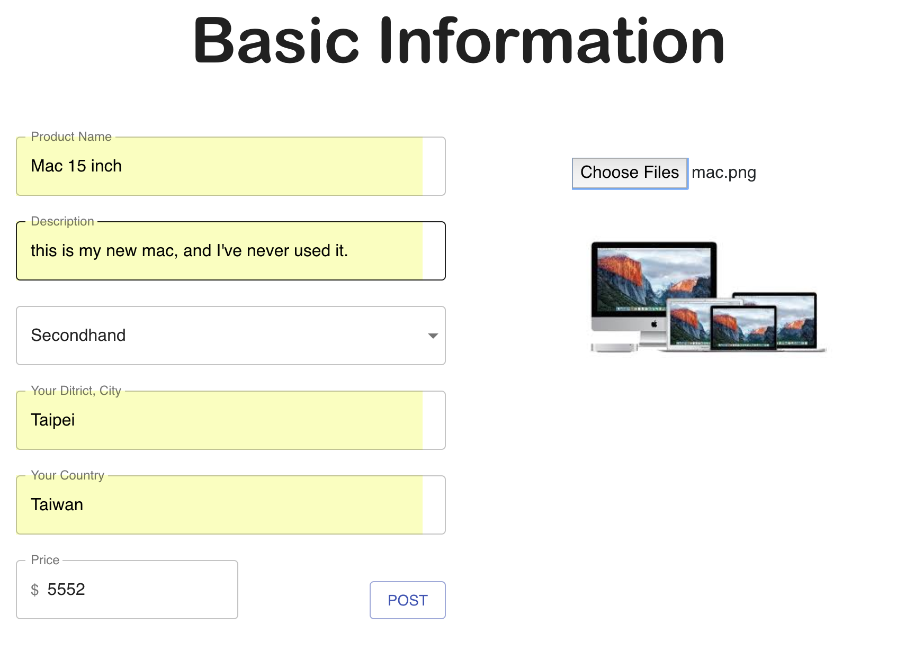
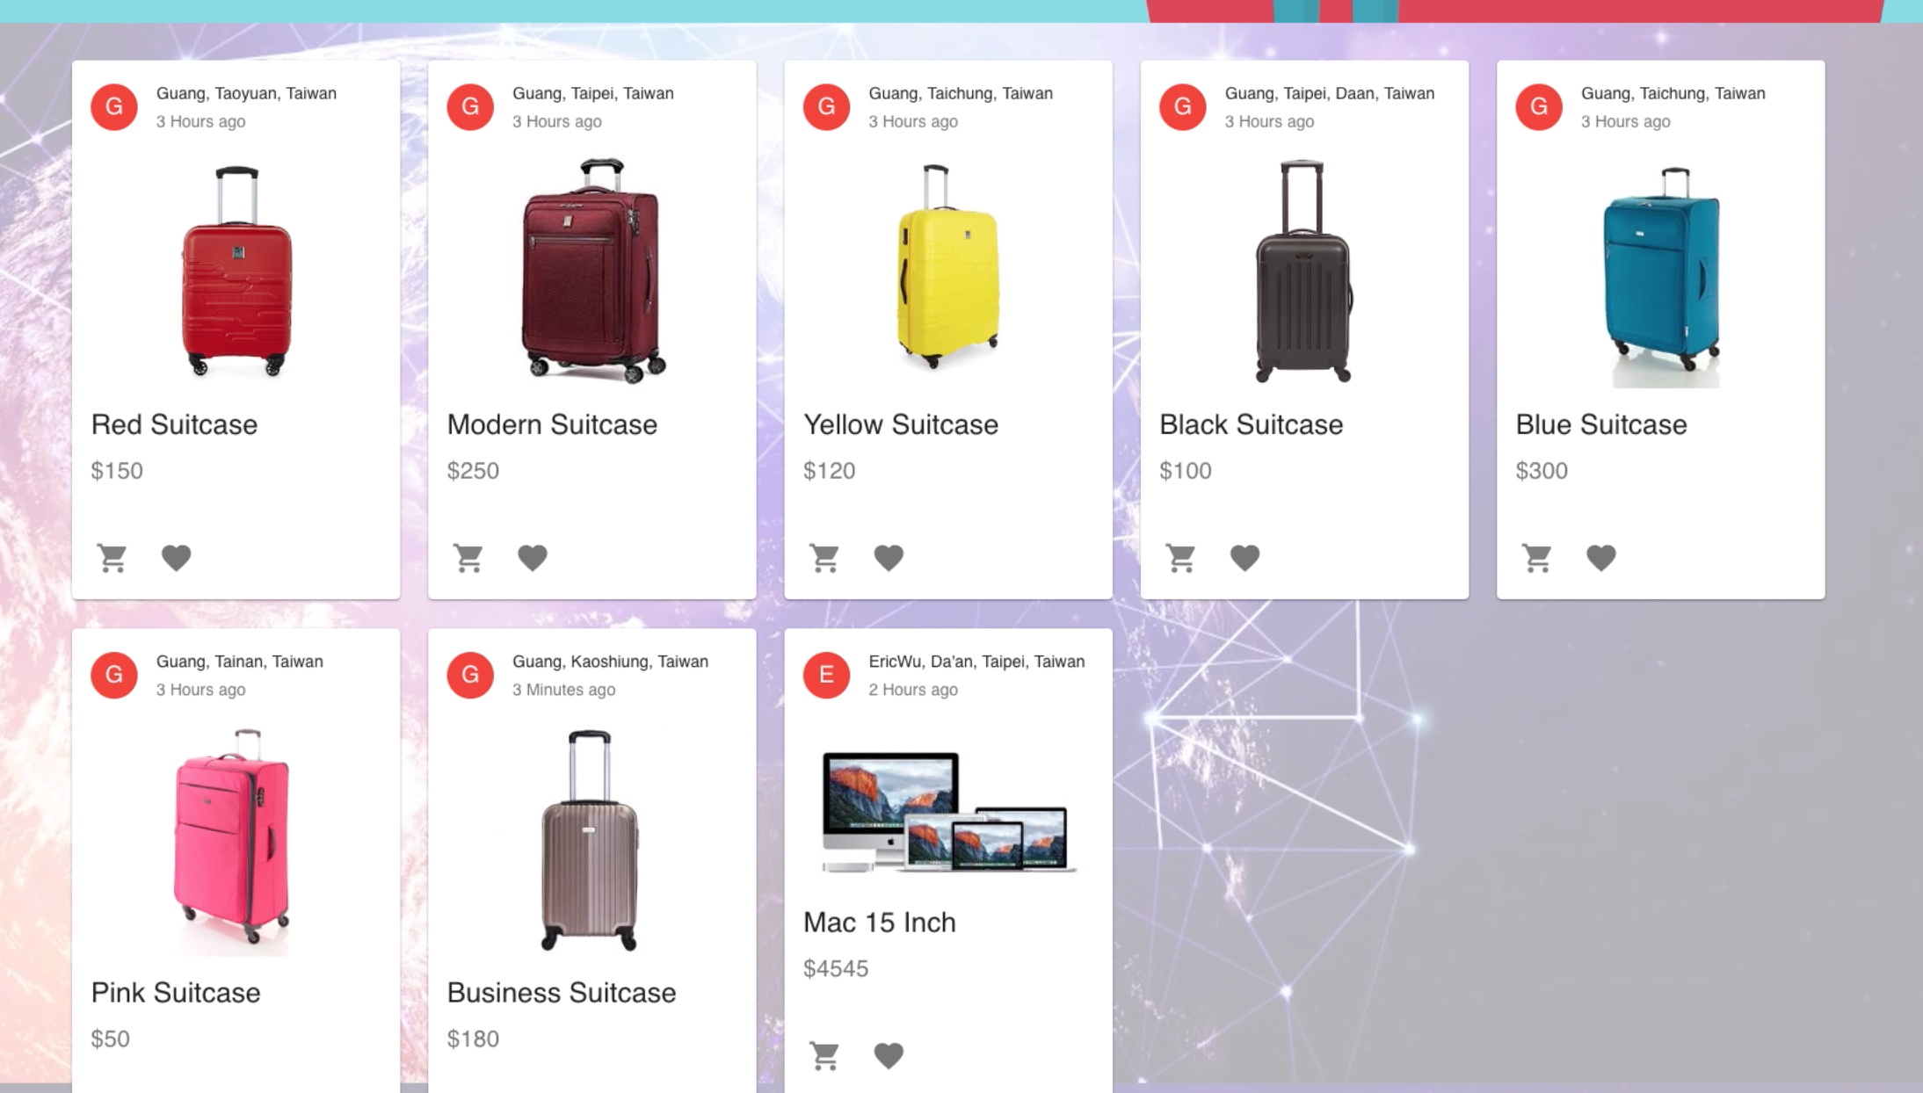
User Interface
Super easy to use
Create account with name, phone number and a little bit money
Login and you can sell or buy or deliver anything

Slide 10
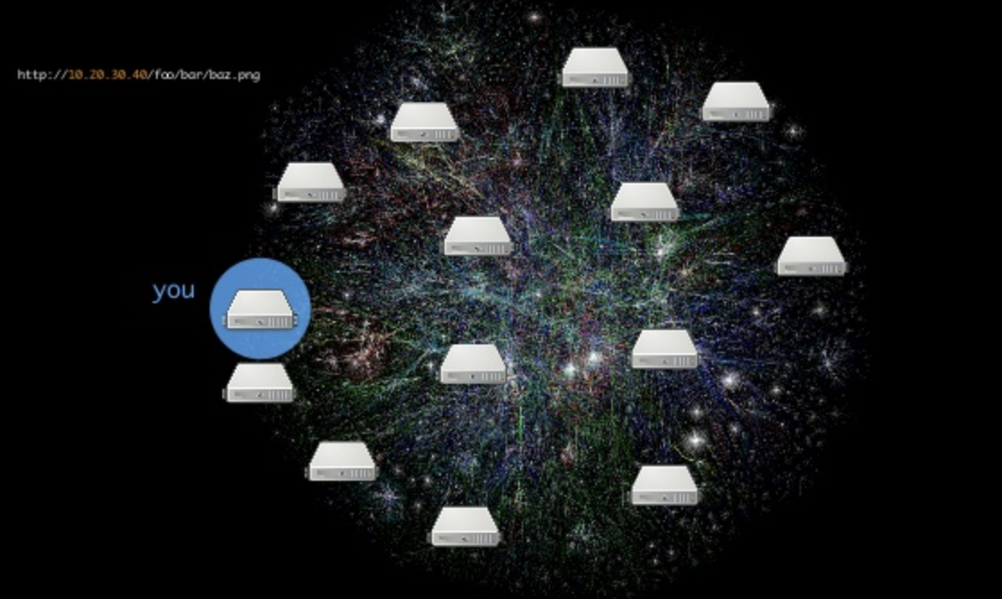
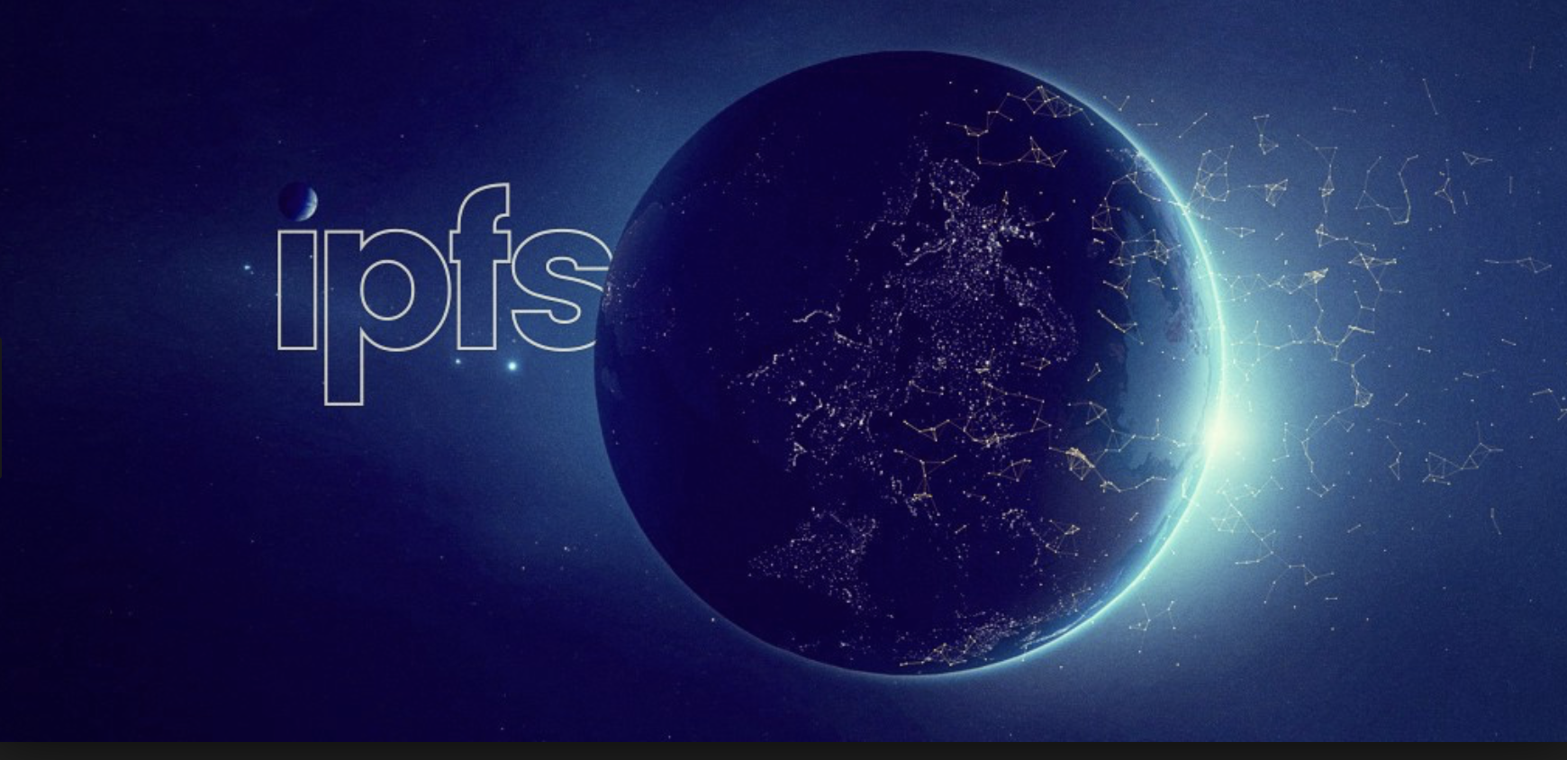
IPFS
Intra-planetart File System
Truly Decentralized, Distributed Database
Perfectly matching with dApps
Saving Data permanently

Slide 11
DEXON
A Block-lattice-based blockchain structure
Unlike Bitcoin and Ethereum, using Total Ordering Concensus Algorithm
Infinite TPS, far faster than the structure aforementioned

Slide 12
Demo

